Slide 1

Facts and Insights about Spiritual Growth in the Episcopal Church
March 6, 2018

Slide 2

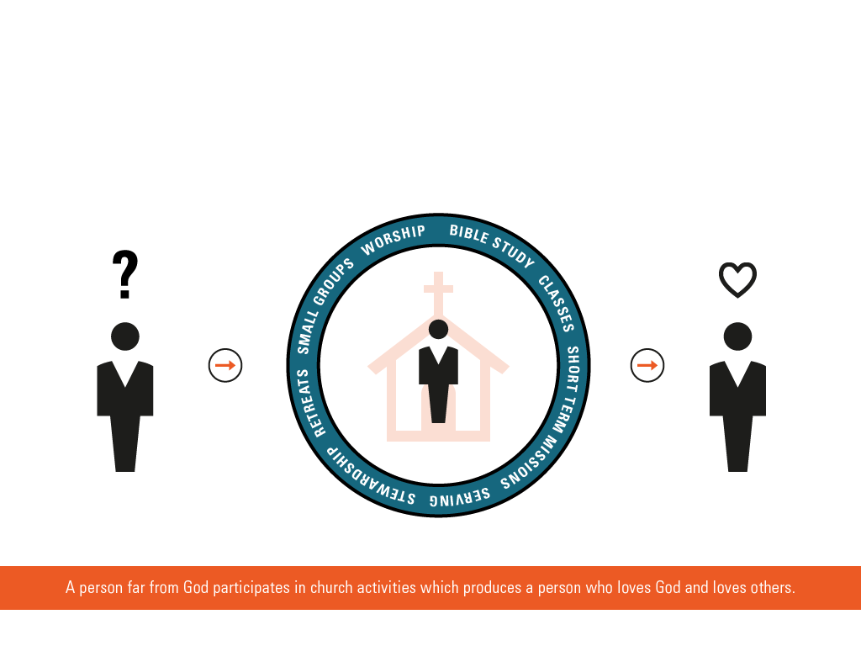
The Church Activity Model for Spiritual Growth
Church Activity Model for Spiritual Growth
Notes:
Following the biblical mandate to go and make disciples of all people groups, churches – empowered by the Holy Spirit – have created various programs with the aim of transforming people who are far from God in to people who love God and love others.

Slide 3
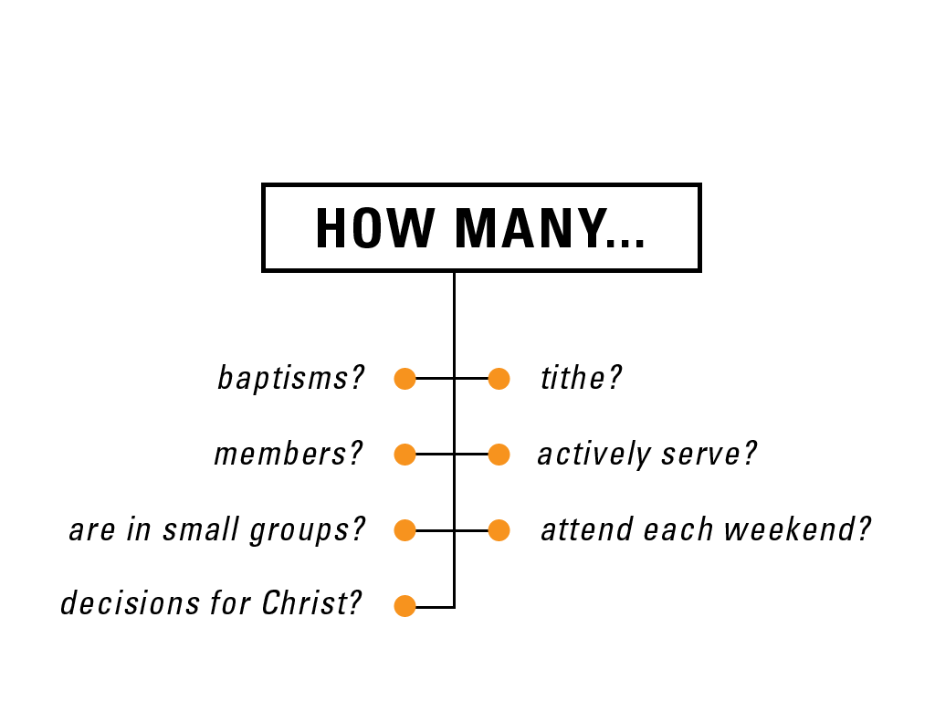
Standard Measures of Ministry “Success”
Standard Measures of Success
Notes:
Main Points:
Typically we measure progress in spiritual growth by asking one fundamental question:
How Many?
This is called an “activity model”. We assumed that increased church activity would translate into spiritual growth, e.g. increased love for God and others.

Slide 4
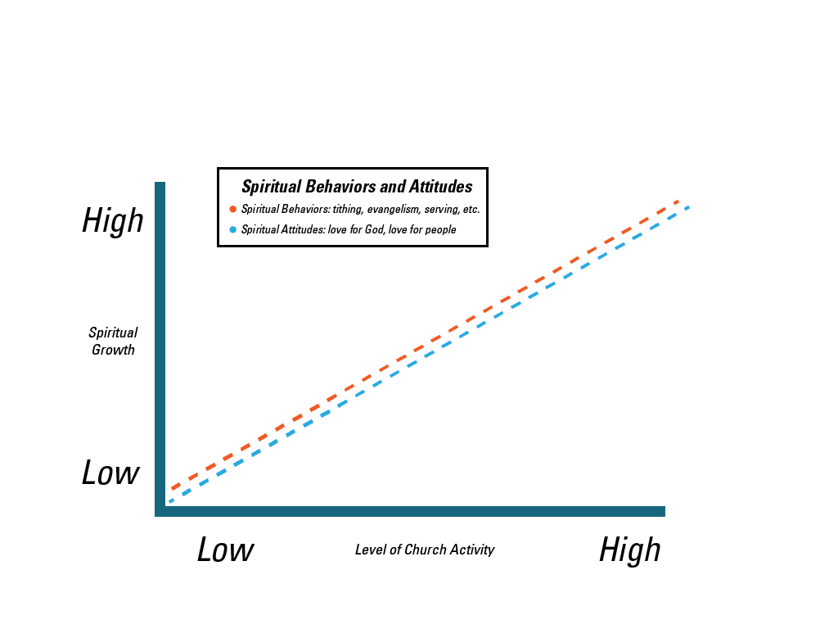
This is what we expected…
Notes:
Main Points:
If the assumption was true – that increased levels of church activities drive spiritual growth – our research findings would have looked like this.
This chart compares how active people are in their church (the horizontal line) with their spiritual growth, measured by their love of God and others plus some key spiritual behaviors, like evangelism (the vertical line).
The blue and orange lines plot how spiritual attitudes and behaviors would track levels of church activity, if the correlation was perfect.
So, if church activity drove spiritual growth, then someone on the far right of the “church activity” line (e.g. who always attends weekend services, participates in small groups and serves the church) would ALSO express high levels of love for God and others, and high levels of spiritual behaviors (like evangelism).
Similarly, people with low participation in church activities would express low levels of spiritual attitudes and behaviors.

Slide 5
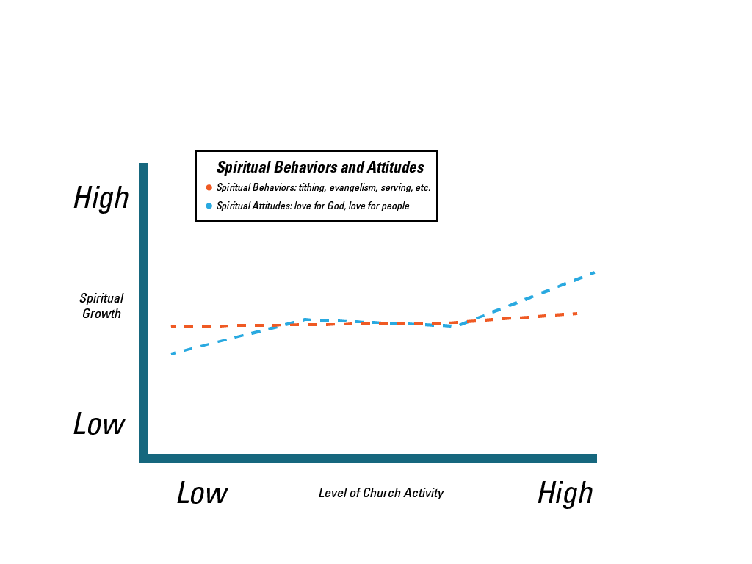
This is what we found…
This is what we found…
Notes:
Main Points:
This is what we found – which looks very different than what we expected to find.
People’s “love of God” and “love of others” (the orange line) is flat. That means there is little correlation between how much people participate in church activities – and how much love they express for God and others.
Spiritual behaviors (the blue line) rise somewhat as people increase their level of participation in church activities, but not as much as we would have expected.
For a church leader, this is a disturbing chart. We devote much of our energy and resources in our church activities – believing those activities transform someone’s heart for God.
If they don’t grow the heart for God, what does?

Slide 6
Who are these people?
The Spiritual Continuum
Total and Episcopal Profile*
(*based on 157 churches with 25,000 congregants)
Christ-Centered
Close to Christ
“My relationship with Jesus is the most important relationship in my life. It guides everything I do.”
Growing in Christ
“I feel really close to Christ and depend on him daily for guidance.”
Exploring Christ
“I believe in Jesus and am working on what it means to get to know him.”
“I believe in God, but I am not sure about Christ. My faith is not a significant part of my life.”
24%
26%
5%
40%
23%
10%
54%
28%
18%
Notes:
These four segments were identified in the original REVEAL research work. Our goal was to understand how spiritual growth occurs (which we defined as increasing love for God and others) and what factors drive – or derail – that growth.
We found that how people define their relationship with Christ is very predictive of spiritual growth. In other words, people’s spiritual attitudes, motivations and behaviors are directly aligned with how they define Christ in their lives. For example, we found much stronger beliefs, more routine spiritual disciplines (e.g. daily Bible study), and greater frequencies of spiritual behaviors (like serving those in need) as people advanced from one segment to the next. So those with the highest levels of evangelism, serving, tithing, prayer, solitude, etc. were those in the Christ-Centered group.
We have tested this “spiritual continuum” in more than 500 churches across a diversity of church sizes, denominations and geographies. We have found that these four segments exist in every congregation.
This chart profiles your church’s spiritual continuum. If you see “up” or “down” arrows, it means that your congregation’s profile is more or less spiritually mature than the total sample.

Slide 7
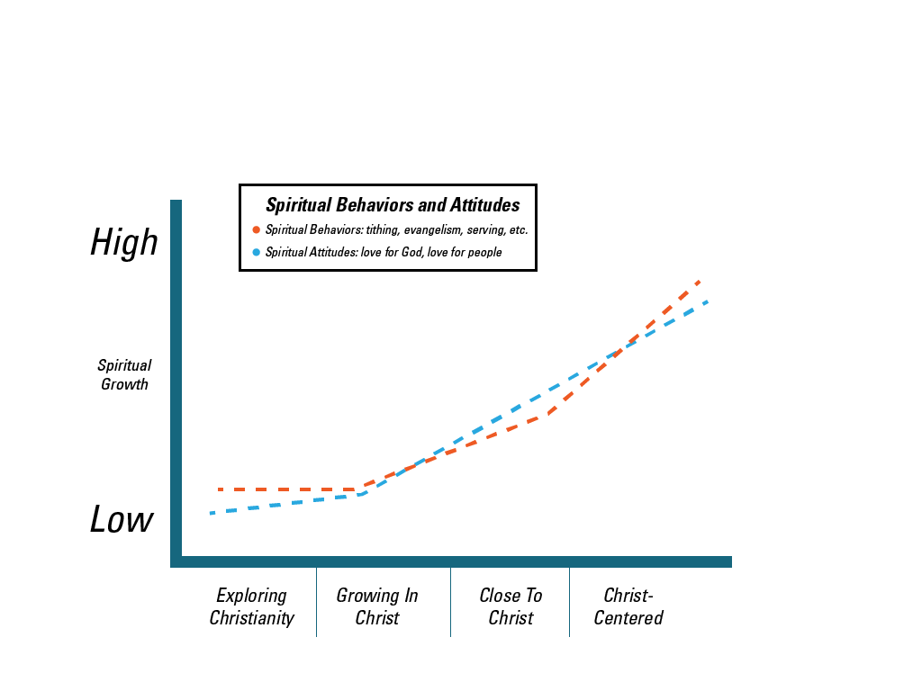
The spiritual continuum predicts spiritual growth.
The Continuum predicts spiritual growth.
Notes:
Main Points:
This research shows the power of this new “view” of spiritual growth. You see that – as intimacy with Christ grows and intensifies – everything else follows.
“Love of God and Others” (the orange line) moves sharply up and to the right
Spiritual behaviors (the blue line), like evangelism and serving those in need, rise dramatically.
This may seem like a no-brainer. Of course, spiritual attitudes and behaviors would rise as you become closer and more intentional in your walk with Christ.
But – what about the church? If its role is fundamentally to inspire spiritual growth, why did increasing participation in its programs produce such lackluster results? Why didn’t the church activity chart look like this?
We’ll unpack the answer to that in the charts ahead.

Slide 8
The BIG question:
What moves people across the continuum?
The BIG Question…
What Moves People From
One Segment to the Next?
Notes:
These four segments were identified in the original REVEAL research work. Our goal was to understand how spiritual growth occurs (which we defined as increasing love for God and others) and what factors drive – or derail – that growth.
We found that how people define their relationship with Christ is very predictive of spiritual growth. In other words, people’s spiritual attitudes, motivations and behaviors are directly aligned with how they define Christ in their lives. For example, we found much stronger beliefs, more routine spiritual disciplines (e.g. daily Bible study), and greater frequencies of spiritual behaviors (like serving those in need) as people advanced from one segment to the next. So those with the highest levels of evangelism, serving, tithing, prayer, solitude, etc. were those in the Christ-Centered group.
We have tested this “spiritual continuum” in more than 500 churches across a diversity of church sizes, denominations and geographies. We have found that these four segments exist in every congregation.
This chart profiles your church’s spiritual continuum. If you see “up” or “down” arrows, it means that your congregation’s profile is more or less spiritually mature than the total sample.

Slide 9
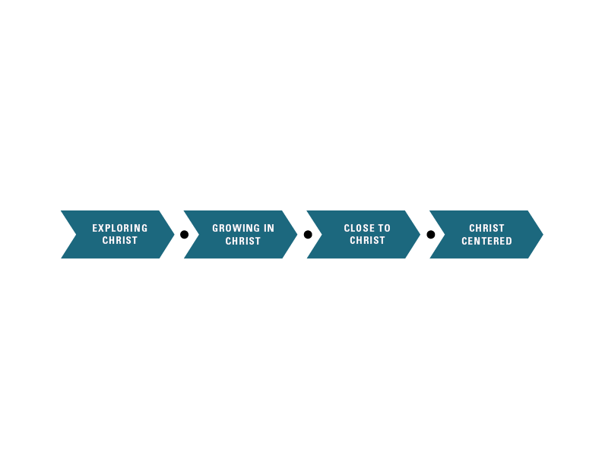
A powerful pattern emerges.
A powerful pattern emerges.
Movement 3
Movement 1
INCREASED SACRIFICE THROUGH
FAITH IN ACTION
BUILDING TRUST THROUGH BELIEFS
Movement 2
COMMUNICATING THROUGH PERSONAL SPIRITUAL PRACTICES
28%
Notes:
These four segments were identified in the original REVEAL research work. Our goal was to understand how spiritual growth occurs (which we defined as increasing love for God and others) and what factors drive – or derail – that growth.
We found that how people define their relationship with Christ is very predictive of spiritual growth. In other words, people’s spiritual attitudes, motivations and behaviors are directly aligned with how they define Christ in their lives. For example, we found much stronger beliefs, more routine spiritual disciplines (e.g. daily Bible study), and greater frequencies of spiritual behaviors (like serving those in need) as people advanced from one segment to the next. So those with the highest levels of evangelism, serving, tithing, prayer, solitude, etc. were those in the Christ-Centered group.
We have tested this “spiritual continuum” in more than 500 churches across a diversity of church sizes, denominations and geographies. We have found that these four segments exist in every congregation.
This chart profiles your church’s spiritual continuum. If you see “up” or “down” arrows, it means that your congregation’s profile is more or less spiritually mature than the total sample.

Slide 10
Core Catalysts of Spiritual Growth
The Catalysts of Spiritual Growth
MOVEMENT 1:
BELIEFS
Catalysts include beliefs in:
  Salvation by Grace
  The Trinity
  Personal God
  Authority of the Bible
MOVEMENT 2:
PERSONAL SPIRITUAL PRACTICES
Catalysts include:
  Reflection on Scripture
  Prayer for Guidance
  Solitude
  Tithing
MOVEMENT 3:
FAITH IN ACTION
Catalysts include:
  Willingness to Risk Everything for Christ
  Evangelism
  Serving Those in Need

Slide 11
But the most powerful catalyst is:
But the most powerful catalyst is…
Christ-Centered
Close to Christ
Growing in Christ
Exploring Christ
Reflection on Scripture is the ONLY CATALYST in the TOP 5 for
all Three Movements.
28%
Notes:
These four segments were identified in the original REVEAL research work. Our goal was to understand how spiritual growth occurs (which we defined as increasing love for God and others) and what factors drive – or derail – that growth.
We found that how people define their relationship with Christ is very predictive of spiritual growth. In other words, people’s spiritual attitudes, motivations and behaviors are directly aligned with how they define Christ in their lives. For example, we found much stronger beliefs, more routine spiritual disciplines (e.g. daily Bible study), and greater frequencies of spiritual behaviors (like serving those in need) as people advanced from one segment to the next. So those with the highest levels of evangelism, serving, tithing, prayer, solitude, etc. were those in the Christ-Centered group.
We have tested this “spiritual continuum” in more than 500 churches across a diversity of church sizes, denominations and geographies. We have found that these four segments exist in every congregation.
This chart profiles your church’s spiritual continuum. If you see “up” or “down” arrows, it means that your congregation’s profile is more or less spiritually mature than the total sample.

Slide 12
How Does REVEAL Help Churches?

Slide 13
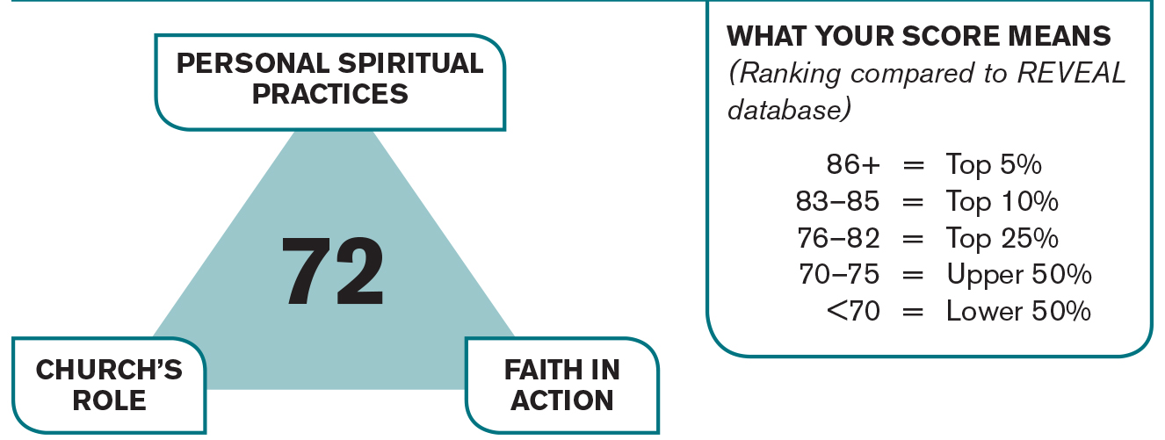
REVEAL’S Spiritual Vitality Index
12
Notes:
12
REVEAL’s Spiritual Vitality Index was designed to offer leaders an overall measure of the spiritual well-being of their congregation, as well as a way to track progress from one survey to another. The score is comprised of the following three major categories related to spiritual growth.
Personal Spiritual Practices – measures the level of engagement with spiritual disciplines, such as reflection on Scripture and prayer, that advance the level of spiritual maturity and intimacy with God (Mark 1:32-38).
These measures were derived from slides 28-31.
Faith in Action – measures spiritual behaviours that mark a Christ-follower, such as evangelism and serving those in need, as well as attitudes of surrender to Christ (Philippians 2:2-8 and James 2:14-18).
These measures were derived from slides 19, 20, and 32-34.
Church’s Role – measures the effectiveness of the church’s role in helping its congregation grow spiritually (Ephesians 4:12-13).
These measures were derived from slides 9-11.

Slide 14
Three Patterns of Spiritual Vitality
Average
Struggling
Thriving
40
50
60
70
80
90
100
Spiritual Vitality Index
13
Notes:
13
REVEAL’s Spiritual Vitality Index was designed to offer leaders an overall measure of the spiritual well-being of their congregation, as well as a way to track progress from one survey to another. The score is comprised of the following three major categories related to spiritual growth.
Personal Spiritual Practices – measures the level of engagement with spiritual disciplines, such as reflection on Scripture and prayer, that advance the level of spiritual maturity and intimacy with God (Mark 1:32-38).
These measures were derived from slides 28-31.
Faith in Action – measures spiritual behaviors that mark a Christ-follower, such as evangelism and serving those in need, as well as attitudes of surrender to Christ (Philippians 2:2-8 and James 2:14-18).
These measures were derived from slides 19, 20, and 32-34.
Church’s Role – measures the effectiveness of the church’s role in helping its congregation grow spiritually (Ephesians 4:12-13).
These measures were derived from slides 9-11.

Slide 15
The Episcopal Spiritual Vitality Profile
Episcopal Church SVI Profile
*Denomination profile is based on 157 churches representing 25,000 congregants.
40
50
60
70
80
90
100
Spiritual Vitality Index
Notes:
14
REVEAL’s Spiritual Vitality Index was designed to offer leaders an overall measure of the spiritual well-being of their congregation, as well as a way to track progress from one survey to another. The score is comprised of the following three major categories related to spiritual growth.
Personal Spiritual Practices – measures the level of engagement with spiritual disciplines, such as reflection on Scripture and prayer, that advance the level of spiritual maturity and intimacy with God (Mark 1:32-38).
These measures were derived from slides 28-31.
Faith in Action – measures spiritual behaviors that mark a Christ-follower, such as evangelism and serving those in need, as well as attitudes of surrender to Christ (Philippians 2:2-8 and James 2:14-18).
These measures were derived from slides 19, 20, and 32-34.
Church’s Role – measures the effectiveness of the church’s role in helping its congregation grow spiritually (Ephesians 4:12-13).
These measures were derived from slides 9-11.

Slide 16
Five “best practices” advance spiritual growth.
By studying Thriving Churches, we found five best practices.
GET PEOPLE MOVING
EMBED THE BIBLE IN EVERYTHING
CREATE OWNERSHIP
PASTOR THE LOCAL COMMUNITY
CHRIST-CENTERED LEADERSHIP

Slide 17

By combining spiritual catalysts and best practices,
we found a new “lens.”
Congregant Characteristics
Church Characteristics

Slide 18


Two Types of Struggling Churches
Congregant Characteristics
Church Characteristics
Spiritually Coasting
Unhappy Congregants
Attendance Declining
14%
17%
Spiritual Apathy
Longtime Spiritual Immaturity
Happy Congregants

Slide 19



Three Types of Average Churches
Spiritually Mature But…
Spiritually Plateaued
Signs of Unrest
Congregant Characteristics
17%
Church-centered Faith
Contented Leaders
Little Sets Church Apart
13%
9%
Church Characteristics
Spiritually Undeveloped
Community Service Enthusiasts
Happy Congregants

Slide 20



Three Types of Thriving Churches
8%
Congregant Characteristics
Growing Attendance and Spirituality
Sky-high Congregant Approval
Challenge Marks the Culture
10%
Spiritually Mature
Congregants Disenchanted With Church
Attendance Stable or Declining
12%
“Buzz” of Spiritual Enthusiasm
Faith Somewhat Church-centered
Very Happy Congregants
Church Characteristics

Slide 21
Eight Church Archetypes
Congregant Characteristics
8%
17%
10%
12%
13%
9%
Church Characteristics
14%
17%

Slide 22
Every church falls into one of the archetypes.

Slide 23
This Episcopal Church is defined by three archetypes.
Self-Motivated
(1%)
Extroverted
(24%)
*Based on 157 churches representing 25,000 congregants.

Slide 24
Every church can Rise!
Congregant Characteristics
Church Characteristics

Slide 25
The Path for the Troubled Church
Congregant Characteristics
Troubled Church Strategies:
Ruthless Reality Check
“Your First Love” Recharge
Integrated, High-profile Bible-based Campaign
Church Characteristics

Slide 26
The Path for the Complacent Church
Congregant Characteristics
Complacent Church Strategies:
“Your First Love” Recharge
Integrated, High-profile Bible-based Campaign
Small Group Build-up
Church Characteristics

Slide 27
The Path for the Extroverted Church
Congregant Characteristics
Extroverted Church Strategies:
Alpha
Integrated, High-profile Bible-based Campaign
Spiritual Role Models and Reminders
Church Characteristics

Slide 28
These congregants want (and need) more from the Episcopal Church.
Congregant Characteristics
Church Characteristics

Slide 29
This can be done, but it’s not about Tweaking!
Congregant Characteristics
Church Characteristics

Slide 30
CASE STUDY:
Memorial Park Presbyterian
Pittsburgh, PA
January 2009

Slide 31
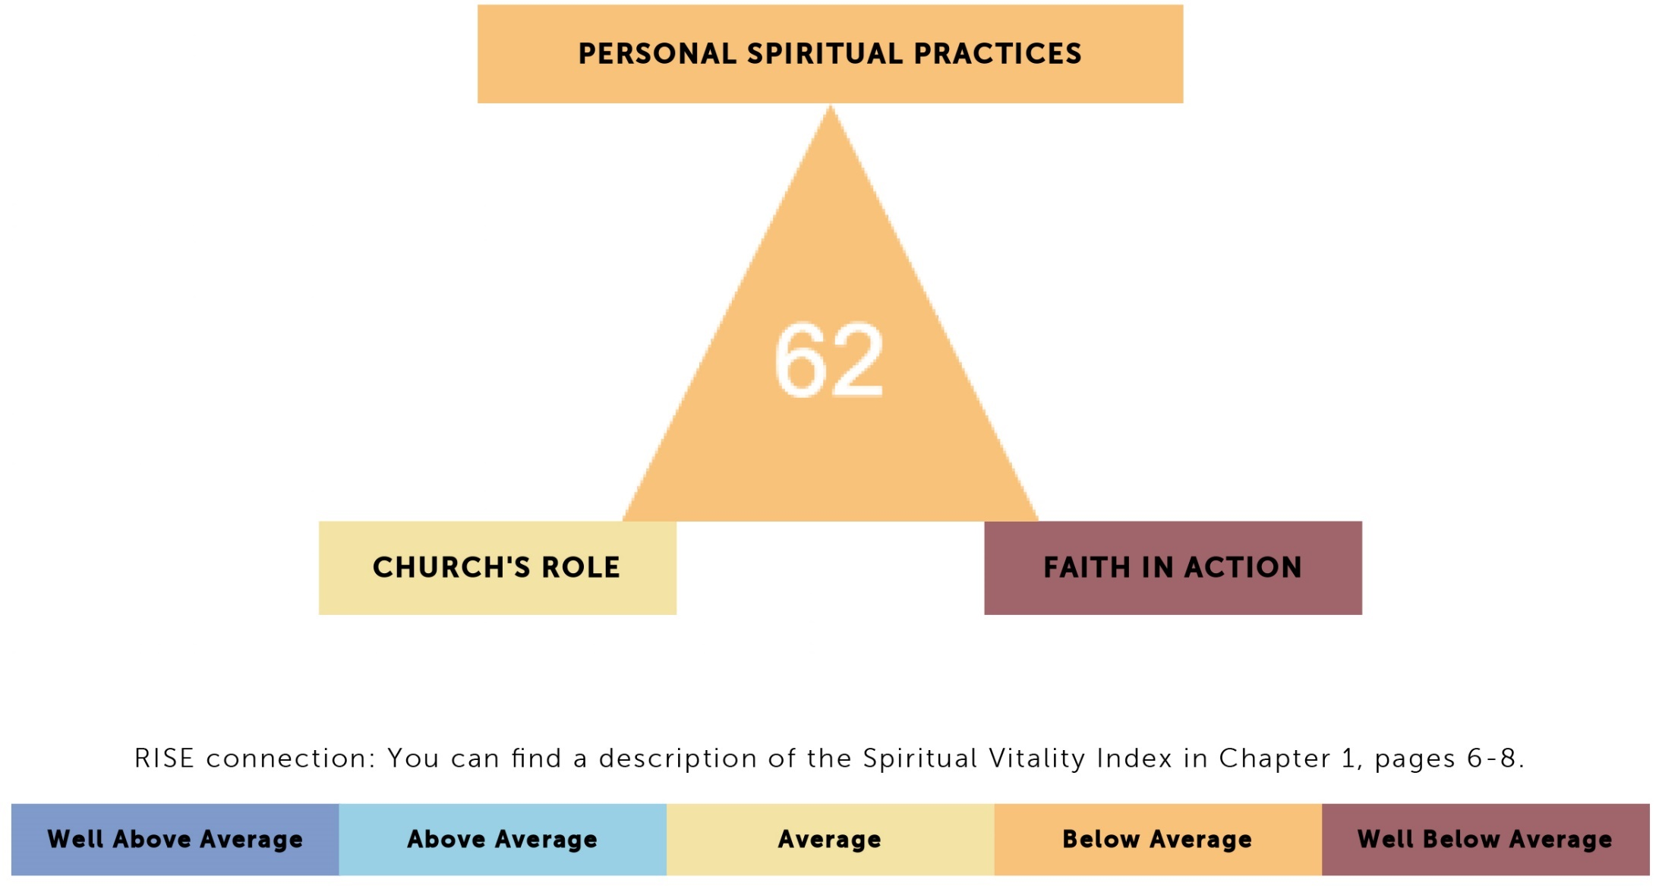
Memorial Park’s SVI

Slide 32
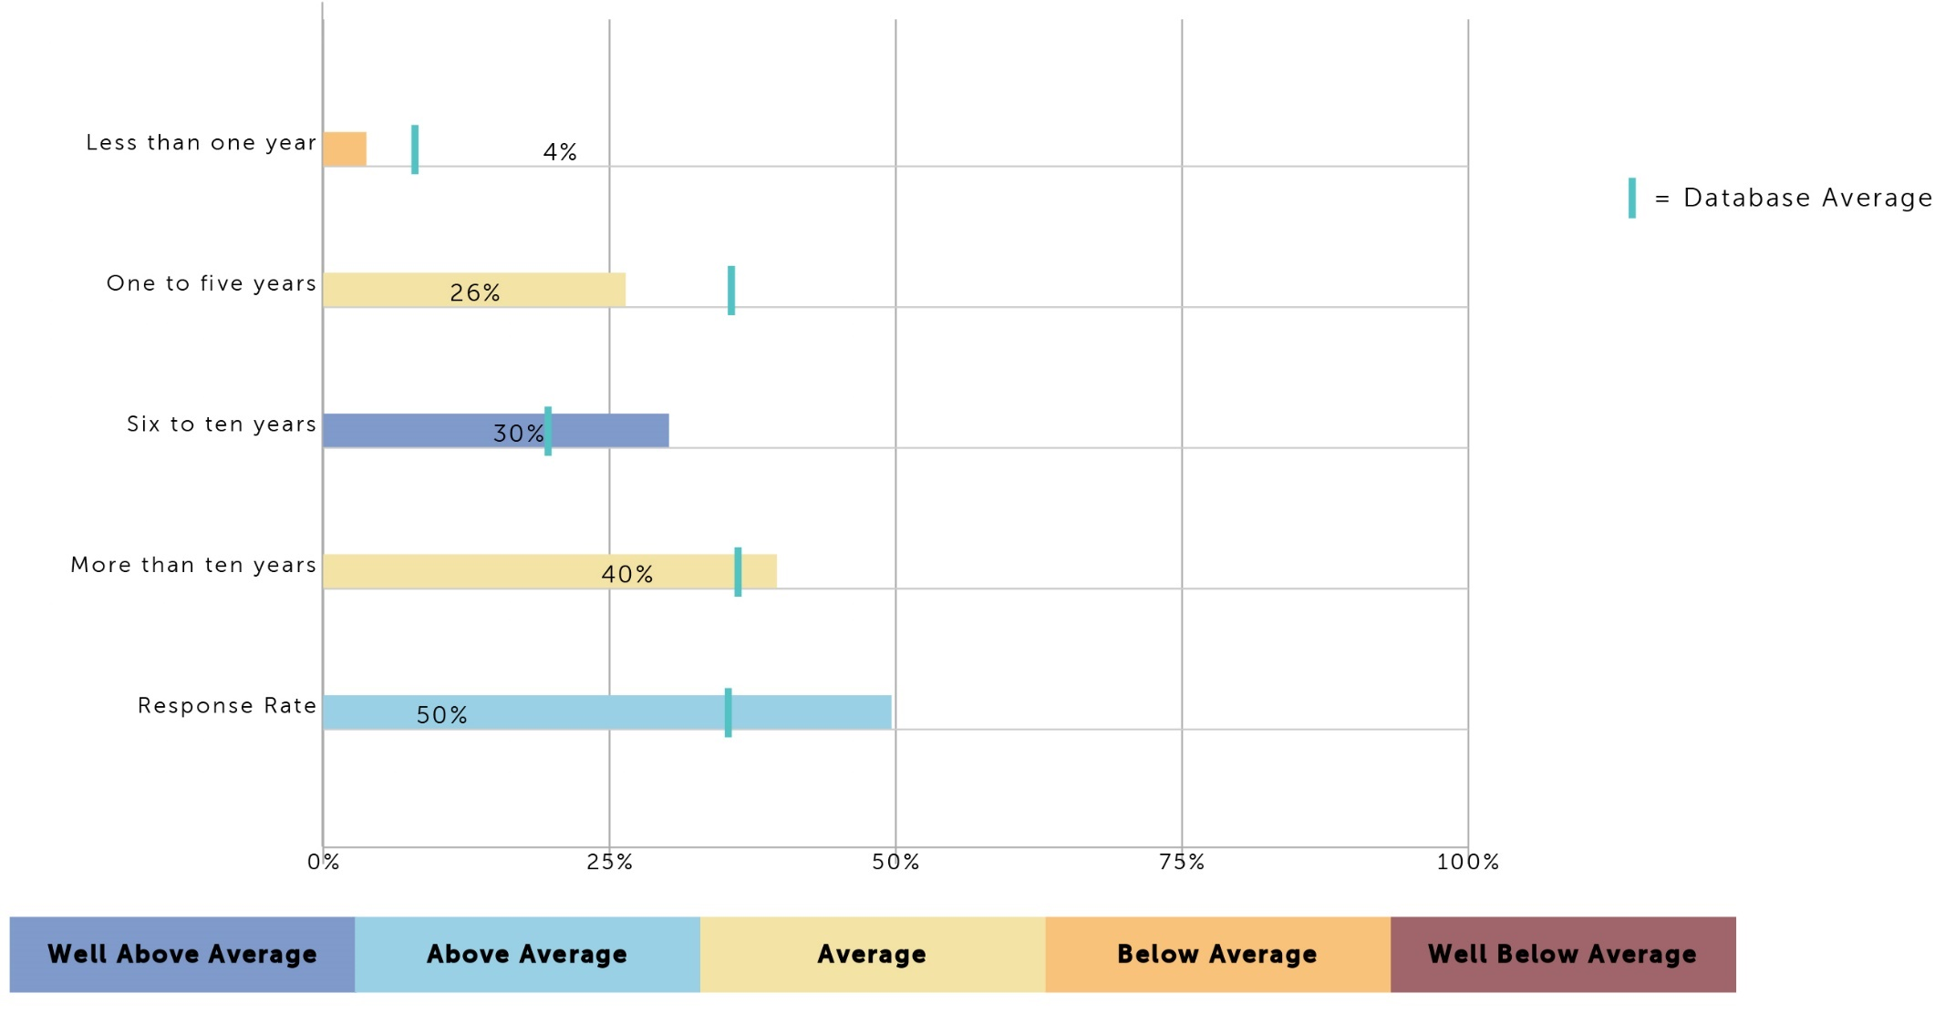
Memorial Park’s Tenure & Response Rate

Slide 33
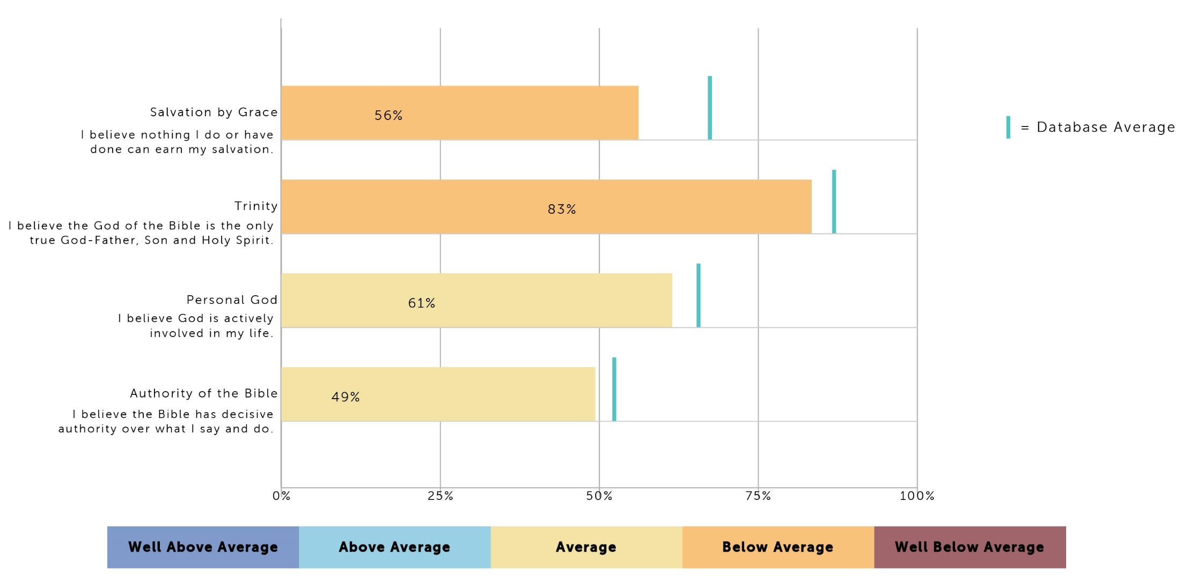
Memorial Park’s Beliefs

Slide 34
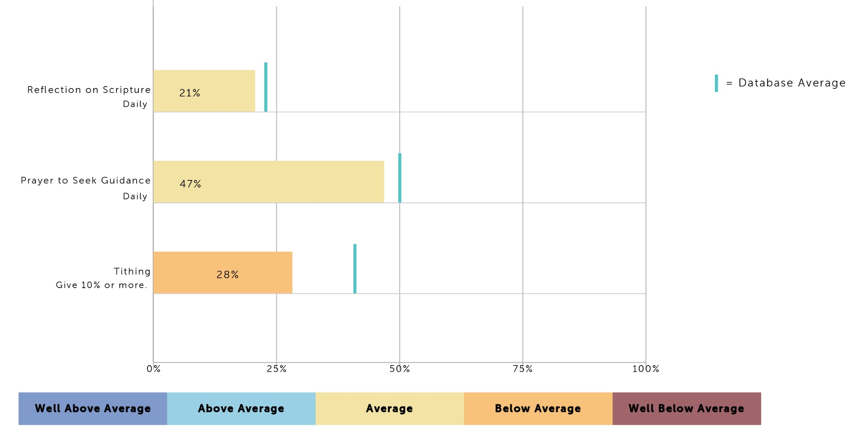
Memorial Park’s Spiritual Practices

Slide 35
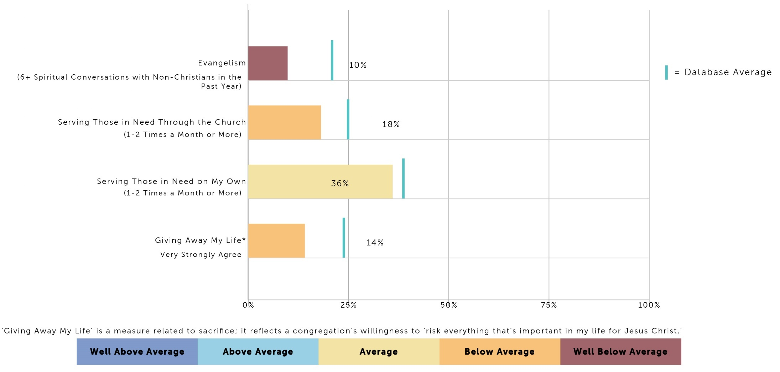
Memorial Park’s Faith in Action

Slide 36
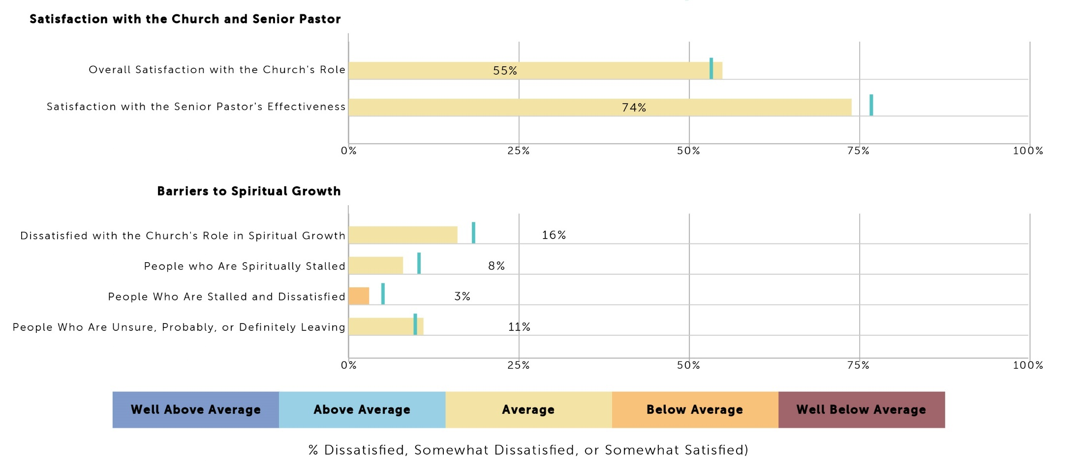
Memorial Park’s Satisfaction
Memorial Park’s Satisfaction & Barriers

Slide 37
Memorial Park’s 2009 Archetype
Congregant Characteristics
Three Characteristics:
  Spiritual Apathy
  Longtime Spiritual Immaturity
  Happy Congregants
Church Characteristics

Slide 38
What Did They Do?
Created a Crunch Team
  Took the data deeper, specific conclusions
  Got staff on board, then deacons
Pursued a Culture Transformation, not a new program
  Goal: authenticity, trust, transparency
  Depended on role modeling by church leaders
  Kick-off was a retreat
Embedded the Bible through teaching
  Delved deeply into the Bible—not the norm
    Taught on Romans for 12 months
  Launched Academy of Faith
  Organized small groups/teaching based on segments

Slide 39
CASE STUDY:
Memorial Park Presbyterian
Pittsburgh, PA
January 2012

Slide 40
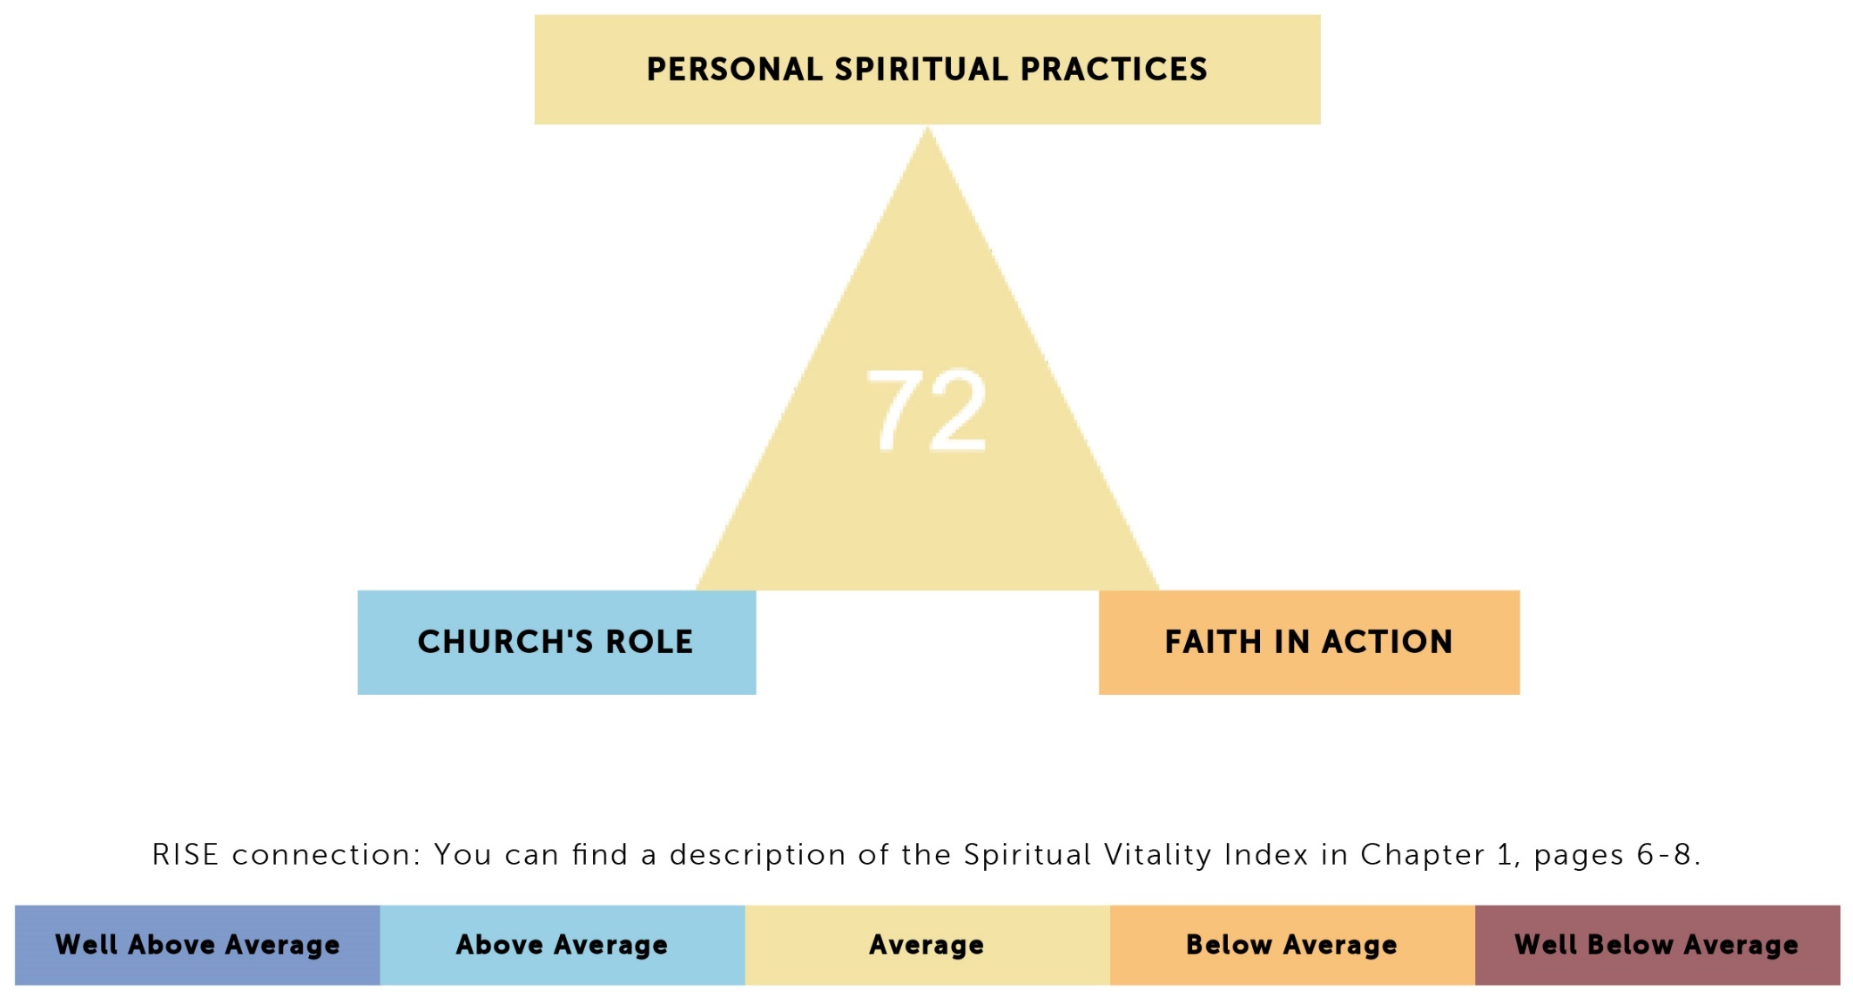
Memorial Park’s 2012 SVI
⇧
⇧
= Compared to Previous Survey
⇧
⇧
⇧

Slide 41
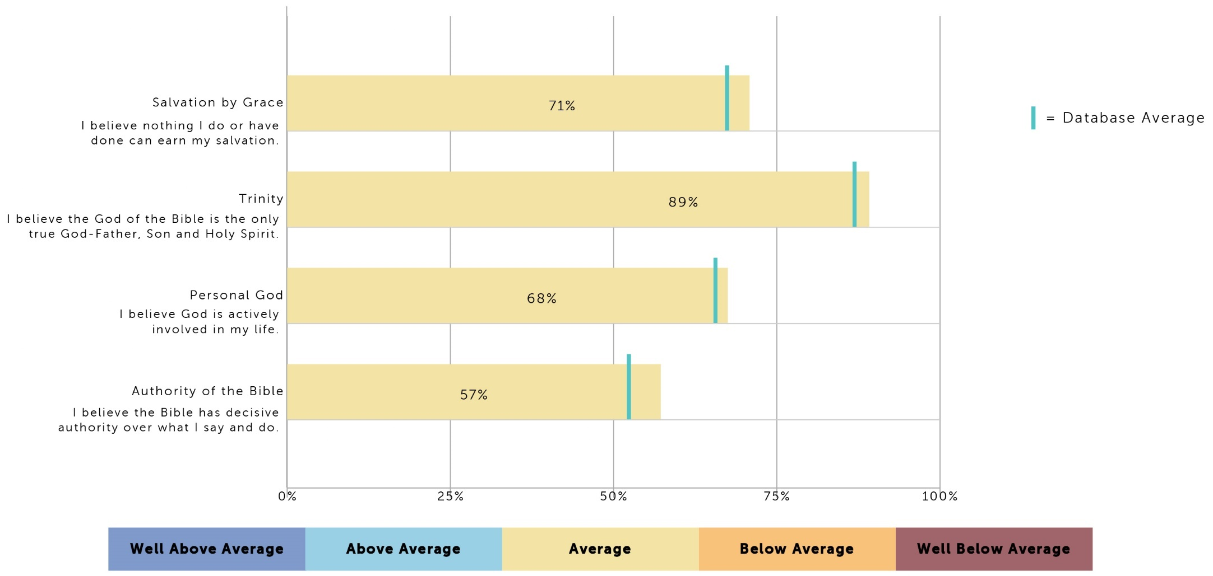
Memorial Park’s 2012 Beliefs
Memorial Park’s Beliefs 2012
⇧
= Previous Survey
⇧
⇧
⇧
⇧

Slide 42
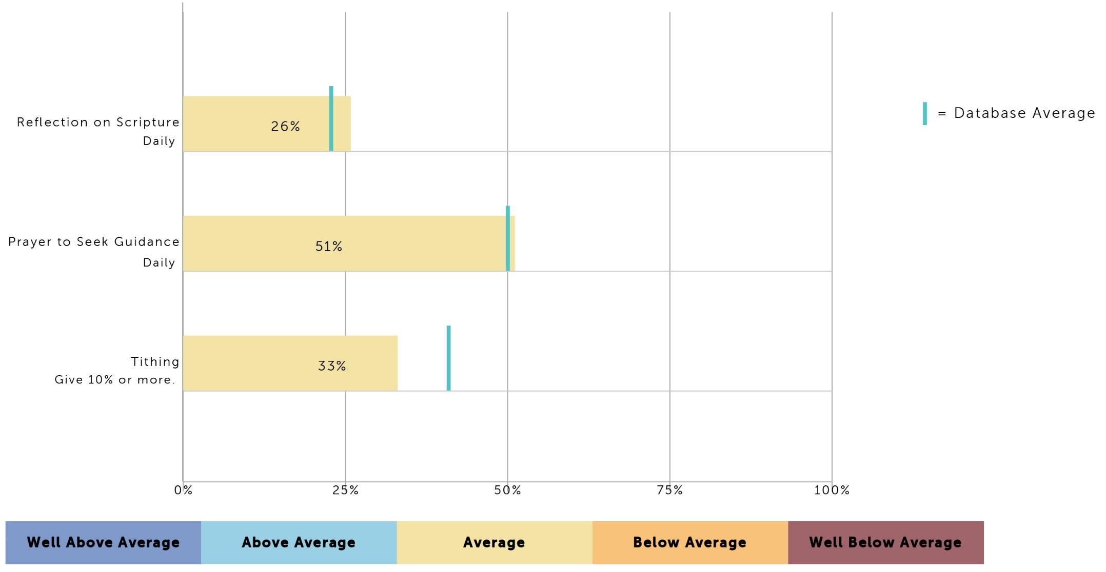
Memorial Park’s Personal Spiritual Practices 2012
Memorial Park’s 2012 Spiritual Practices
⇧
= Previous Survey
⇧
⇧
⇧

Slide 43
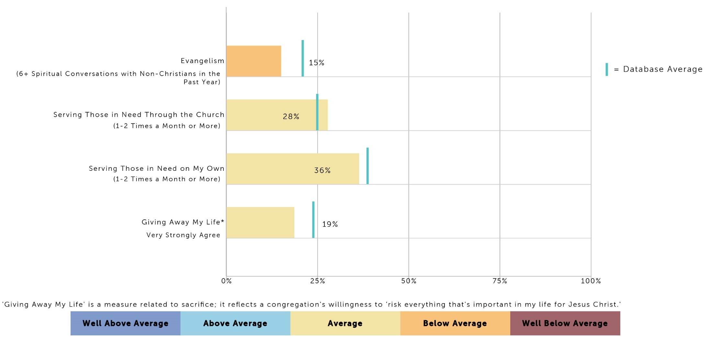
Memorial Park’s 2012 Faith in Action
⇧
= Previous Survey
⇧
⇧
⇧
⇧

Slide 44
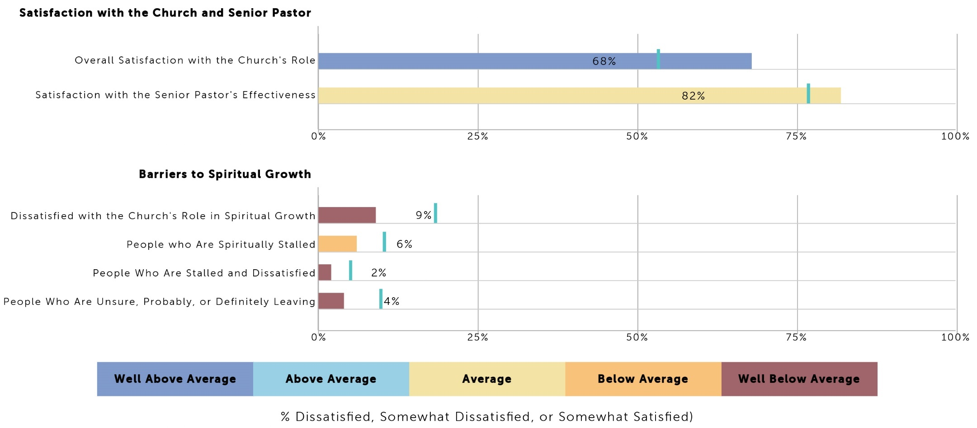
Memorial Park’s Satisfaction 2012
Memorial Park’s 2012 Satisfaction & Barriers
⇧
= Previous Survey
⇧
⇧

Slide 45
Memorial Park’s 2012 Archetype
Congregant Characteristics
Three Characteristics:
  “Buzz” of Spiritual Enthusiasm
  Faith Somewhat Church-centered
  Very Happy Congregants
Church Characteristics

